Slide 1


Cesar Pedraja
02/06/2025

Slide 2

Outline
Executive Summary
Introduction
Methodology
Results
Conclusion
Appendix

Slide 3
Executive Summary
The Following Methodologies were used to analyze the data
Data Processing & Cleaning: Loading, standardizing, and transforming SpaceX launch data.
Exploratory Data Analysis (EDA): Statistical summaries, and visualizations (scatter plots, bar charts, pie charts) to identify trends.
Machine Learning Models: Logistic Regression, SVM, Decision Tree, and KNN trained and optimized using GridSearchCV.
Geospatial Analysis: Mapping launch sites, success rates, and calculating distances using Folium and Haversine formula.
Summary of All Results
Launch Success Trends: Higher payloads do not always guarantee success; success rates vary by launch site and orbit type.
Best Performing Model: Among all ML models tested, [insert best model based on results] achieved the highest accuracy.
Geospatial Insights: Most SpaceX launches occurred at CCAFS LC-40 and KSC LC-39A, with varied success rates.
Dashboard Interactivity: The Dash app effectively visualized launch data, allowing users to filter by site and payload mass.

Slide 4
Introduction
Project background and context
SpaceX has revolutionized the aerospace industry with reusable rocket technology, leading to cost reductions and increased launch frequency.
This project analyzes historical SpaceX launch data to identify trends, success rates, and key performance factors using data science and machine learning methodologies.
The dataset includes launch details such as payload mass, launch site, orbit type, booster version, and mission outcomes.
Desirable answers
Identify key factors that contribute to a successful SpaceX launch.
Determine the impact of payload mass on launch success rates.
Find the most effective machine learning model for predicting launch outcomes.
Extract geospatial insights regarding SpaceX launch site locations and performance.

Slide 5

Section 1

Slide 6
Methodology
Executive Summary
Data collection methodology:
Data from Space X was obtained from 2 sources:
Space X API (https://api.spacexdata.com/v4/rockets/)
WebScraping (https://en.Wikipedia.org/wiki/List_of_Falcon/_9/_and_Falcon_Heavy_launches)
Perform data wrangling
Collected data was enriched by creating a landing outcome label based on outcome data after summarizing and analyzing features
Perform exploratory data analysis (EDA) using visualization and SQL

Slide 7
Methodology
Executive Summary
Perform interactive visual analytics using Folium and Plotly Dash
Perform predictive analysis using classification models
Train and Optimize Classification Models: Implement Logistic Regression, SVM, Decision Tree, and KNN, tuning hyperparameters using GridSearchCV to improve performance.
Evaluate Model Performance: Compare models based on accuracy, precision, recall, and confusion matrices to determine the best predictor of launch success.
Feature Engineering for Better Predictions: Convert categorical variables into numerical features, normalize data, and analyze key factors affecting launch outcomes.
Deploy Predictive Insights: Use the best-performing model to forecast future SpaceX launch successes based on payload mass, launch site, and orbit type.

Slide 8
Data Collection
Data sets were collected from Space X API (https://api.spacexdata.com/v4/rockets/) and from Wikipedia (https://en.Wikipedia.org/wiki/List_of_Falcon/_9/_and_Falcon_Heavy_launches), using web scraping technics.

Slide 9
Data Collection – SpaceX API
SpaceX offers a public API from where data can be obtained and then used;
This API was used according to the flowchart beside and then data is persisted.
Source code: https://github.com/cesarPedraja/Applied-Data-Science-Capstone
Request API and parse the SpaceX launch data
Filter data to only include Falcon 9 launches
Deal with missing Values

Slide 10
Data Collection - Scraping
Data from SpaceX launches can also be obtained from Wikipedia;
Data are downloaded from Wikipedia according to the flow
Source code: https://github.com/cesarPedraja/Applied-Data-Science-Capstone
Request the Falcon9 Launch Wiki page
Extract all column/variable names from the HTML table header
Crete data frame by parsing the launch HTML tables

Slide 11
Data Wrangling
Exploratory Data Analysis (EDA) was performed on the dataset.
Next, summaries were created regarding the number of launches per site, the frequency of each orbit type, and the occurrence of mission outcomes per orbit category.
Finally, the landing outcome label was derived from the Outcome column.
EDA
Summaries
The outcome label was derived

Slide 12
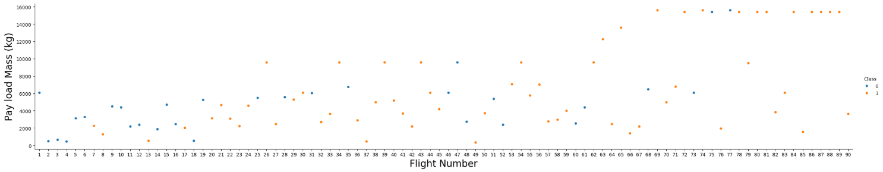
EDA with Data Visualization
To analyze the dataset, scatterplots, and bar charts were utilized to represent the relationships between feature pairs.
The examined relationships included: Payload Mass vs. Flight Number, Launch Site vs. Flight Number, Launch Site vs. Payload Mass, Orbit vs. Flight Number, and Payload vs. Orbit.
Source code: https://github.com/cesarPedraja/Applied-Data-Science-Capstone/blob/main/Assignment%20Exploring%20and%20Preparing%20Data.py

Slide 13
EDA with SQL
The following SQL queries were executed: Retrieved the distinct launch site names used in the space mission.
Identified the top five launch sites whose names start with ‘CCA’.
Calculated the total payload mass transported by boosters launched by NASA (CRS).
Computed the average payload mass carried by the F9 v1.1 booster version.
Determined the date of the first successful landing on a ground pad.
Listed the names of boosters that successfully landed on a drone ship and had a payload mass between 4000 and 6000 kg.
Counted the total number of successful and failed mission outcomes.
Identified the booster versions that transported the highest payload mass.
Retrieved information about failed landings on drone ships, including booster versions and launch site names, for the year 2015.
Ranked the number of landing outcomes (such as drone ship failures or ground pad successes) between June 4, 2010, and March 20, 2017
Source Code: https://github.com/cesarPedraja/Applied-Data-Science-Capstone/blob/main/Assignment%20SQL%20Notebook%20for%20Peer%20Assignment.py

Slide 14
Build an Interactive Map with Folium
Markers, circles, lines, and marker clusters were implemented in Folium maps. Markers represent specific locations, such as launch sites.
Circles, like the NASA Johnson Space Center, highlight areas around certain coordinates.
Marker clusters group multiple events at the same coordinate, such as multiple launches from a single site.
Lines depict the distances between two geographic points.
Source Code: https://github.com/cesarPedraja/Applied-Data-Science-Capstone/blob/main/Interactive%20Visual%20Analytics%20with%20Folium.py

Slide 15
Build a Dashboard with Plotly Dash
The following charts and visualizations were used to represent the data:
Launch site distribution by percentage
Payload range analysis
This combination enabled a quick assessment of the relationship between payloads and launch sites, facilitating the identification of the most suitable locations for launches based on payload data.
Source Code: https://github.com/cesarPedraja/Applied-Data-Science-Capstone/blob/main/Build%20an%20Interactive%20Dashboard%20with%20Ploty%20Dash.py

Slide 16
Predictive Analysis (Classification)
Four classification models were compared: logistic regression, support vector machine, decision tree, and k nearest neighbors.
Test of each model with combinations of hyperparameters
Data Preparation and standardization
Comparison of results
Source Code: https://github.com/cesarPedraja/Applied-Data-Science-Capstone/blob/main/Complete%20the%20Machine%20Learning%20Prediction%20lab.py

Slide 17
Results
Exploratory data analysis findings: SpaceX operates from four distinct launch sites.
The initial launches were conducted for SpaceX itself and NASA.
The F9 v1.1 booster has an average payload capacity of 2,928 kg.
The first successful landing occurred in 2015, five years after the initial launch.
Several Falcon 9 booster versions successfully landed on drone ships with payloads exceeding the average.
Nearly all mission outcomes were successful.
In 2015, two booster versions, F9 v1.1 B1012 and F9 v1.1 B1015, failed to land on drone ships.
Over time, the frequency of successful landings improved.

Slide 18
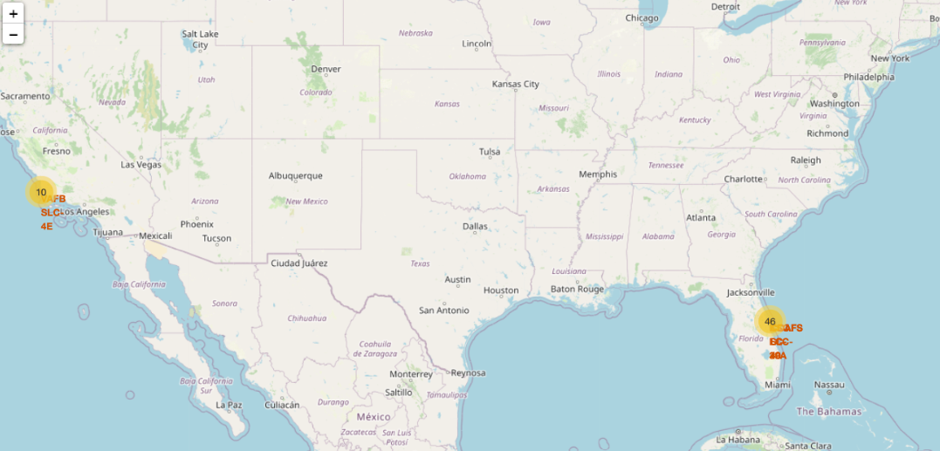
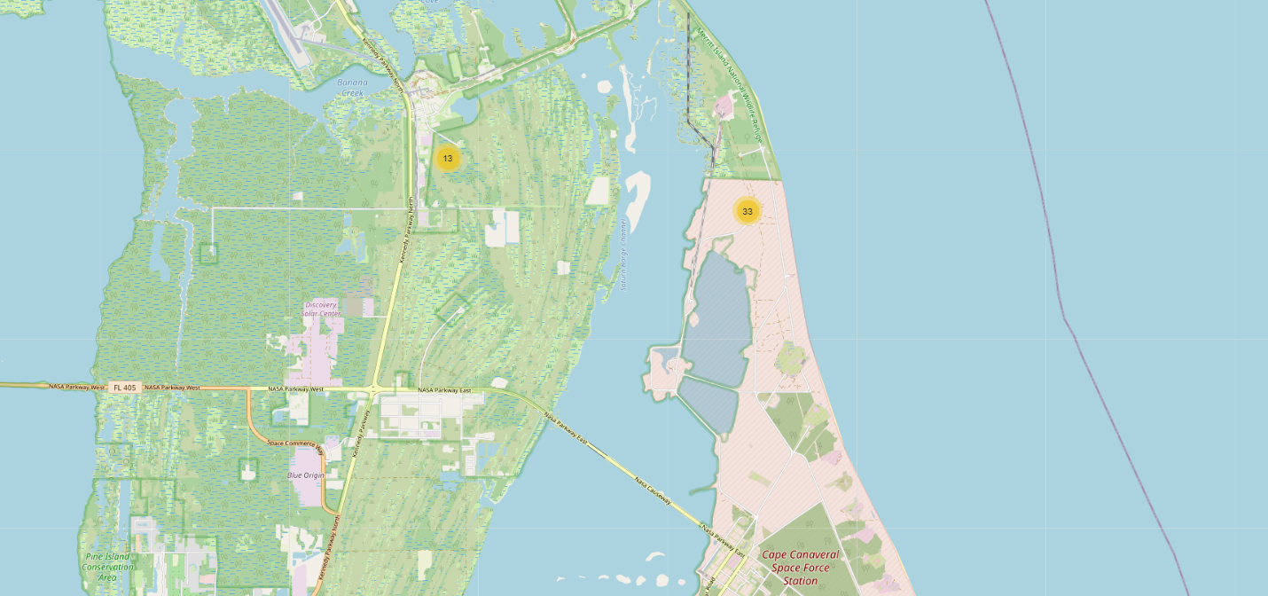
Results
Using interactive analytics was possible to identify that launch sites use to be in safe places, near the sea, and have a good logistic infrastructure around.
More launches happen at the east cost than west cost sites.

Slide 19

Section 2

Slide 20
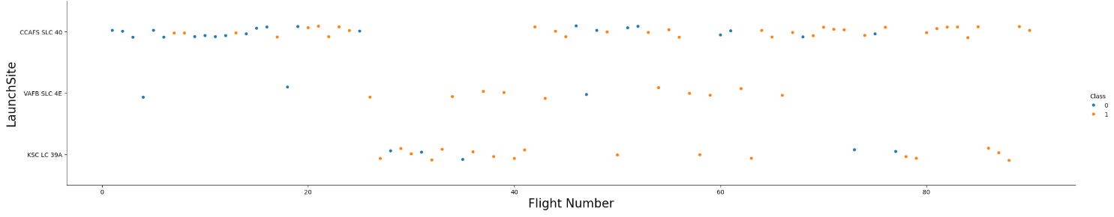
Flight Number vs. Launch Site
Based on the plot above, it can be confirmed that the most effective launch site currently is CCAFS SLC 40, where the majority of recent launches have been successful.
VAFB SLC 4E ranks second, followed by KSC LC 39A in third place.
Additionally, the overall success rate has shown improvement over time.

Slide 21
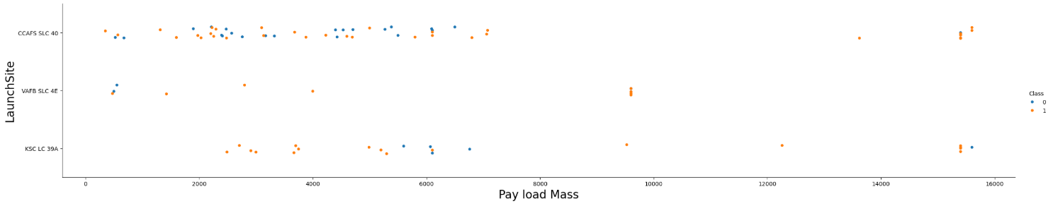
Payload vs. Launch Site
Payloads exceeding 9,000 kg (approximately the weight of a school bus) have a very high success rate.
Launches carrying payloads above 12,000 kg appear to be feasible only at the CCAFS SLC 40 and KSC LC 39A launch sites.

Slide 22
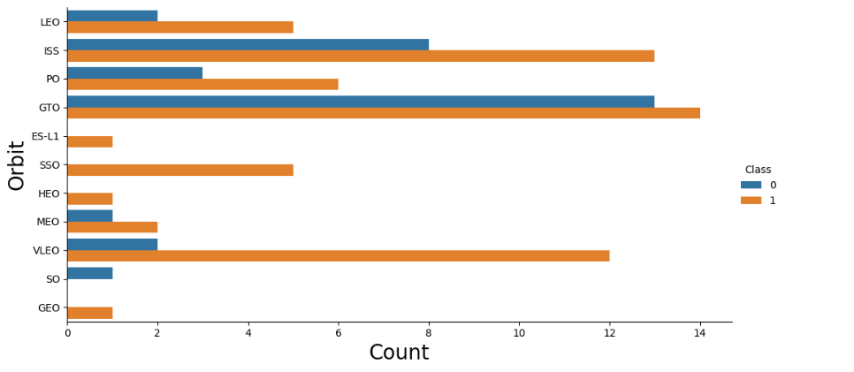
Success Rate vs. Orbit Type
Highest success rates: VLEO, GTO, and ISS have the most successful landings, with VLEO showing an almost perfect success rate.
Most failures: LEO and PO have a high number of failed landings compared to other orbits.
Success rate comparison: ISS orbit has over 80% success rate, while LEO has around 60%, making ISS a more reliable target for landings.

Slide 23
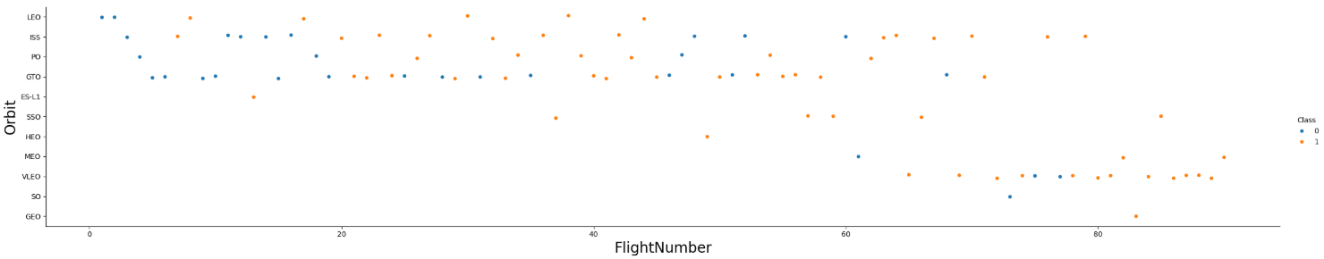
Flight Number vs. Orbit Type
LEO orbit shows a success pattern: Higher flight numbers in LEO (Low Earth Orbit) are associated with more successful landings, suggesting experience and improvements over time.
GTO orbit lacks correlation: In GTO (Geostationary Transfer Orbit), there is no clear relationship between flight number and success rate, indicating that other factors influence landing outcomes.

Slide 24
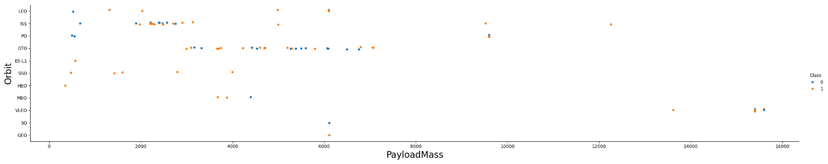
Payload vs. Orbit Type
Higher payloads succeed more in LEO, PO, and ISS: Missions with heavy payloads tend to have higher success rates in Low Earth Orbit (LEO), Polar Orbit (PO), and the International Space Station (ISS) compared to other orbits.
GTO orbit has mixed results: In GTO (Geostationary Transfer Orbit), there is no clear distinction between successful and failed landings, indicating inconsistent success rates regardless of payload size.
Extreme payloads (>12,000 kg) are rare and have mixed success: Only a few missions exceed 12,000 kg, and they show both success and failure, suggesting that very heavy payloads are challenging across all orbits.

Slide 25
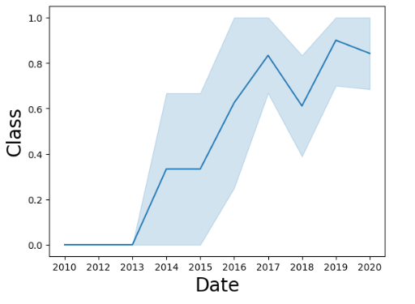
Launch Success Yearly Trend
Significant improvement after 2013: The success rate remained low before 2013 but started increasing steadily from 2013 onward, indicating advancements in launch technology.
Peak success around 2018-2019: The highest success rate was observed between 2018 and 2019, suggesting a period of strong performance in landing missions.
Consistent high success by 2020: By 2020, the trend stabilized at a high success rate, showing that SpaceX achieved a reliable landing system over the years.

Slide 26
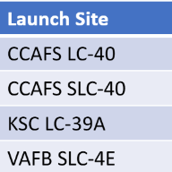
All Launch Site Names
According to data, there are four launch sites:
They are obtained by selecting unique occurrences of “launch_site” values from the dataset.

Slide 27
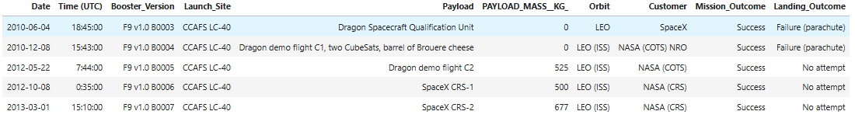
Launch Site Names Begin with 'CCA'
Find 5 records where launch sites begin with `CCA`

Slide 28
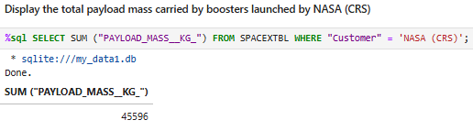
Total Payload Mass
Calculate the total payload carried by boosters from NASA
Explanation & Finding:
The SQL query calculates the total payload mass (in kg) carried by boosters launched by NASA (CRS) using the SUM() function on the "PAYLOAD_MASS_KG_" column, filtering only rows where the "Customer" is "NASA (CRS)". The result shows that NASA's CRS missions have transported 45,596 kg in total.

Slide 29
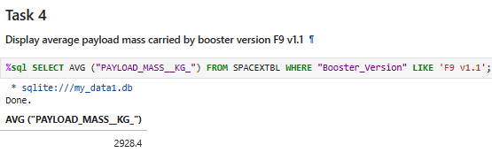
Average Payload Mass by F9 v1.1
Calculate the average payload mass carried by booster version F9 v1.1
Explanation & Finding:
The SQL query calculates the average payload mass (in kg) carried by the booster version F9 v1.1 using the AVG() function on the "PAYLOAD_MASS_KG_" column, filtering only rows where "Booster_Version" matches 'F9 v1.1'. The result shows that the F9 v1.1 booster carried an average payload of 2,928.4 kg.

Slide 30
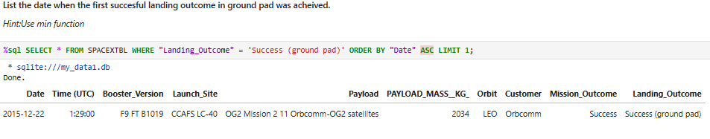
First Successful Ground Landing Date
Find the dates of the first successful landing outcome on ground pad
Explanation & Finding:
The SQL query retrieves the earliest successful landing on a ground pad by selecting all columns from SPACEXTBL, filtering rows where "Landing_Outcome" is 'Success (ground pad)', and ordering results by "Date" in ascending order, limiting to one result. The first successful ground pad landing occurred on December 22, 2015, using the F9 FT B1019 booster at CCAFS LC-40 for the Orbcomm OG2 Mission 2.

Slide 31
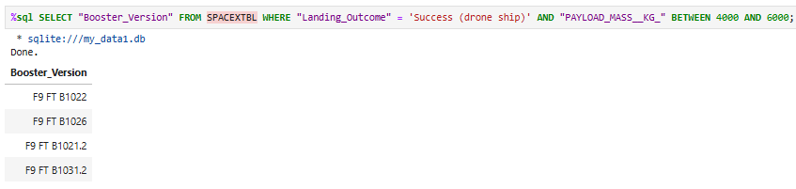
Successful Drone Ship Landing with Payload between 4000 and 6000
List the names of boosters which have successfully landed on drone ship and had payload mass greater than 4000 but less than 6000
Explanation & Finding:
The SQL query retrieves the booster versions that successfully landed on a drone ship while carrying a payload mass between 4000 and 6000 kg. The query filters rows where "Landing_Outcome" is 'Success (drone ship)' and "PAYLOAD_MASS_KG_" falls within the specified range.

Slide 32
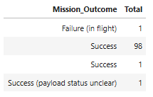
Total Number of Successful and Failure Mission Outcomes
Calculate the total number of successful and failure mission outcomes
Explanation & Finding:
The SQL query counts the total number of mission outcomes by grouping the results based on the "Mission_Outcome" column. The results show that 98 missions were successful, while there was one in-flight failure and one success with an unclear payload status. Additionally, there is a duplicate "Success" entry, which might indicate a data inconsistency.

Slide 33
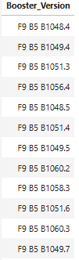
Boosters Carried Maximum Payload
List the names of the booster which have carried the maximum payload mass
Explanation & Finding:
The SQL query retrieves the booster versions that carried the maximum payload mass by using a subquery to find the highest value in the "PAYLOAD_MASS_KG_" column. The results show that multiple booster versions achieved this maximum payload, including F9 B5 B1048.4, F9 B5 B1049.4, and F9 B5 B1051.3, among others.

Slide 34
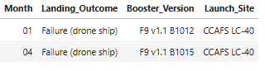
2015 Launch Records
List the failed landing_outcomes in drone ship, their booster versions, and launch site names for in year 2015
Explanation & Finding:
The SQL query extracts month names and filters records for failed drone ship landings in the year 2015 using substr(Date, 6,2) for months and substr(Date,0,5) for the year. The results show that two failures occurred in January (01) and April (04) 2015, both using the F9 v1.1 B1012 and B1015 boosters at CCAFS LC-40 launch site.

Slide 35
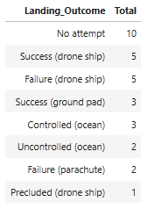
Rank Landing Outcomes Between 2010-06-04 and 2017-03-20
Rank the count of landing outcomes (such as Failure (drone ship) or Success (ground pad)) between the date 2010-06-04 and 2017-03-20, in descending order
Explanation & Finding:
The SQL query ranks landing outcomes from 2010-06-04 to 2017-03-20 by counting occurrences and ordering them in descending order. The most common result was "No attempt" (10 times), followed by "Success (drone ship)" and "Failure (drone ship)" (5 times each). Ground pad successes were less frequent (3 times), while other outcomes, such as controlled/uncontrolled ocean landings and parachute failures, were rarer.

Slide 36

Section 3

Slide 37
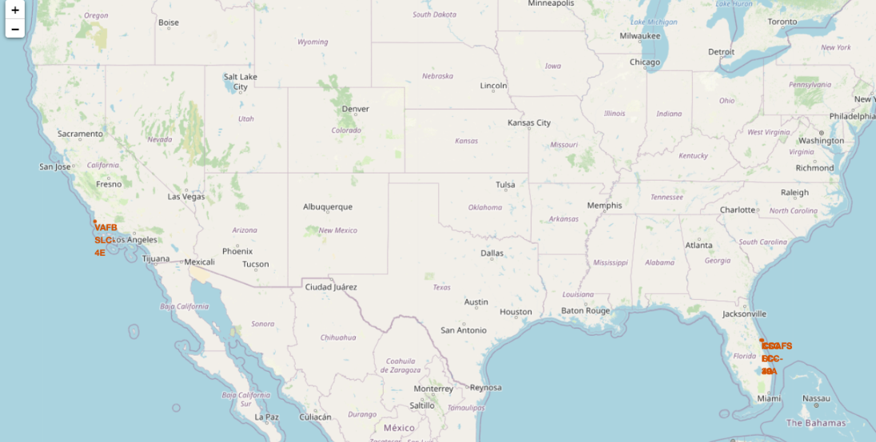
All launch sites on a map
The map highlights SpaceX's main launch sites in the U.S., with a clear concentration in Florida (CCAFS and KSC) and California (VAFB SLC 4E). The higher density of launch sites in Florida suggests its strategic advantage for equatorial and geostationary orbits, while the California site is likely used for polar orbits, demonstrating a diverse orbital launch capability.

Slide 38
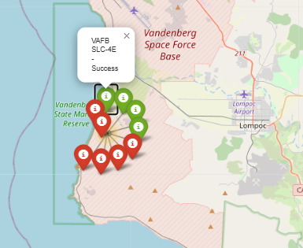
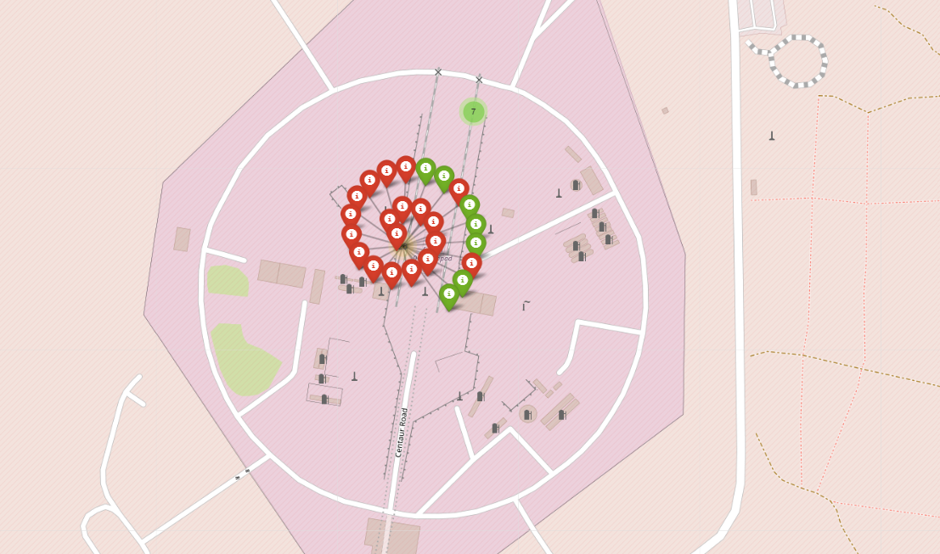
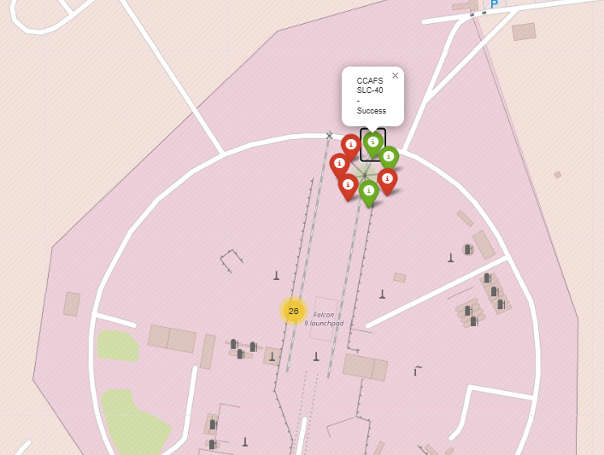
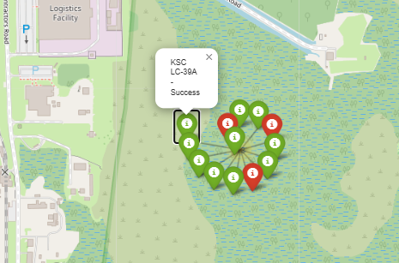
success/failed launches for each site on the map
Green marks indicate success and red marks indicate failure.

Slide 39
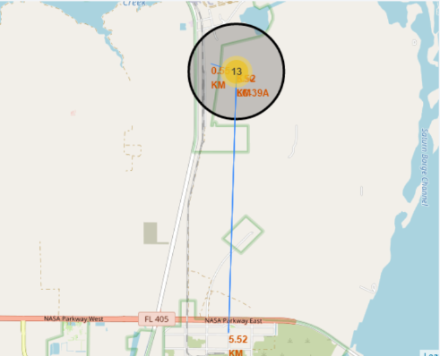
Distances between a launch site to its proximities
Launch sites are located near railroads, and roads, and relatively far from inhabited areas, this is a good logistic aspect.

Slide 40

Section 4

Slide 41
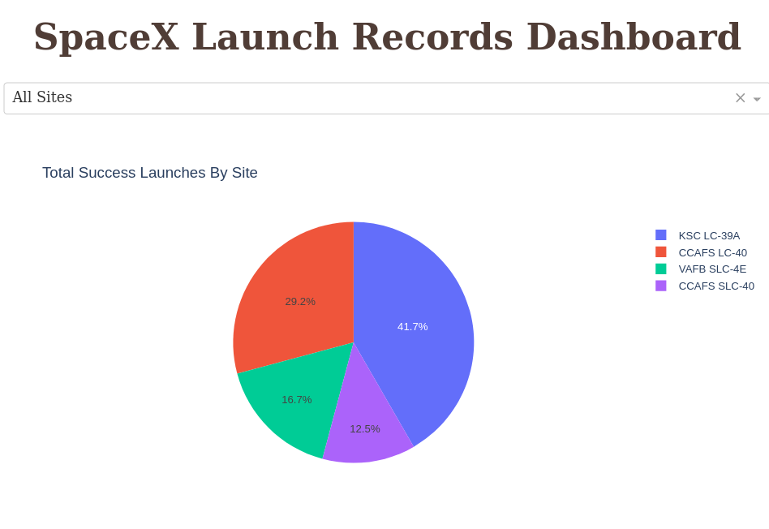
Successful Launches by Site
Key Insight: The pie chart shows that KSC LC-39A has the highest number of successful launches (41.7%), followed by CCAFS LC-40 (29.2%). VAFB SLC-4E (16.7%) and CCAFS SLC-40 (12.5%) have significantly fewer successful launches. This indicates that KSC LC-39A is the most utilized and successful launch site for SpaceX missions.

Slide 42
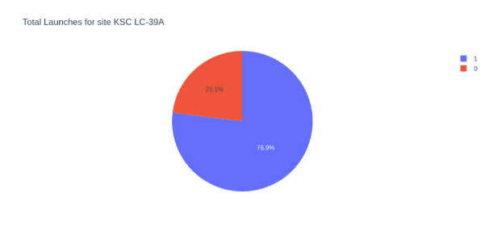
Launch Success Ratio for KSC LC-39A
Key Insight: The pie chart represents the total launches for the KSC LC-39A site, showing that 76.9% were successful (blue), while 23.1% failed (red). This indicates a high success rate for launches from this site, making it one of SpaceX’s most reliable locations.

Slide 43
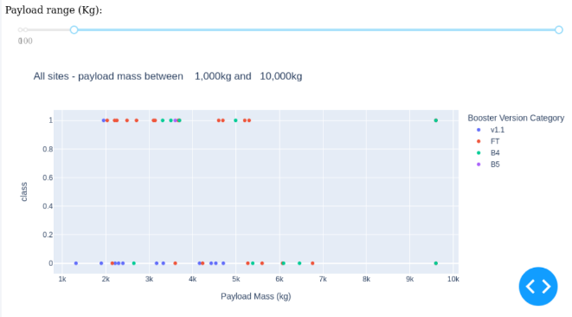
Payload vs. Launch Outcome Scatter plot
Payloads under 6000 kg and FT boosters are the most successful combination.

Slide 44

Section 5

Slide 45
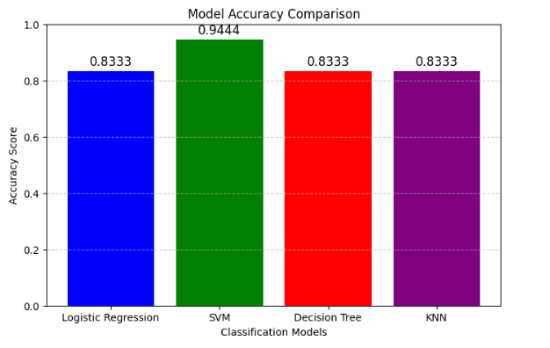
Classification Accuracy
Key Insight: The SVM model (94.44% accuracy) outperforms all other classification models, making it the most effective for this dataset. Meanwhile, Logistic Regression, Decision Tree, and KNN all achieve an accuracy of 83.33%, indicating similar performance but slightly lower than SVM. This suggests that SVM is the best choice for this classification task.

Slide 46
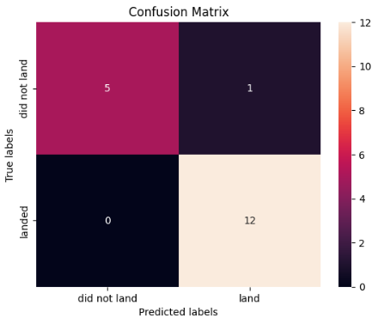
Confusion Matrix
Confusion Matrix Analysis (SVM)
True Positives: 12 → Correctly predicted landings.
True Negatives: 5 → Correctly predicted non-landings.
False Positives: 1 → Incorrectly predicted a landing.
False Negatives: 0 → No missed landings.
Key Insight: The SVM model performs exceptionally well, with only one misclassification, making it highly reliable for predicting landings.

Slide 47
Conclusions
Various data sources were examined, refining insights throughout the analysis.
KSC LC-39A was identified as the most effective launch site.
Missions carrying payloads exceeding 7,000 kg tend to have lower risk.
While most missions are successful, landing success rates have improved over time due to advancements in rocket technology and processes.
The SVM model can help forecast successful landings, optimizing efficiency and profitability.

Slide 48
Appendix
Key Python Code Snippets:
Code for model training, hyperparameter tuning, or feature selection.
Example: Logistic Regression, SVM, Decision Tree, or KNN implementation.
SQL Queries Used:
Queries for extracting launch data, calculating success rates, or identifying the best launch sites.
Data Visualizations:
Screenshots or embedded versions of confusion matrices, accuracy comparison bar charts, or trend analysis graphs.
Notebook Outputs:
Results from Pandas DataFrames, model evaluation metrics, or statistical summaries.
Datasets or Sources:
Mention or link the dataset(s) used, such as SpaceX launch records.
Additional Findings:
Any extra insights or relevant notes that were not included in the main presentation but support the analysis.
Including a mix of these elements will add value and completeness to the project documentation.

Slide 49


